Slide 1

SANDEEP KODARI
COMPUTER SCIENCE AND ENGINEERING
VARDHAMAN COLLEGE OF ENGINEERING
STUID:STU61b4d3d9ecaa81639240665

Slide 2


Slide 3


Slide 4
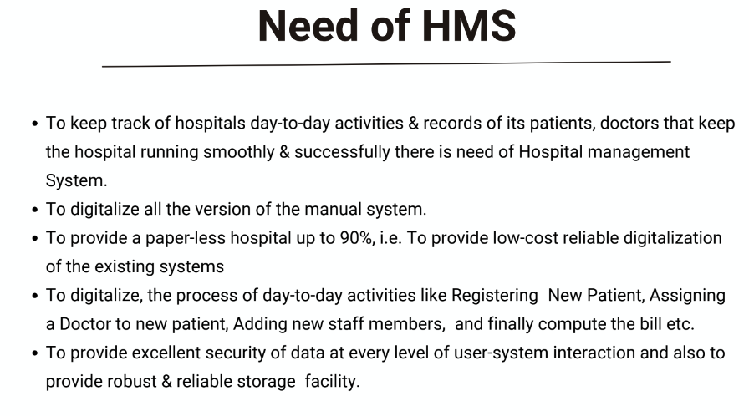

Slide 5
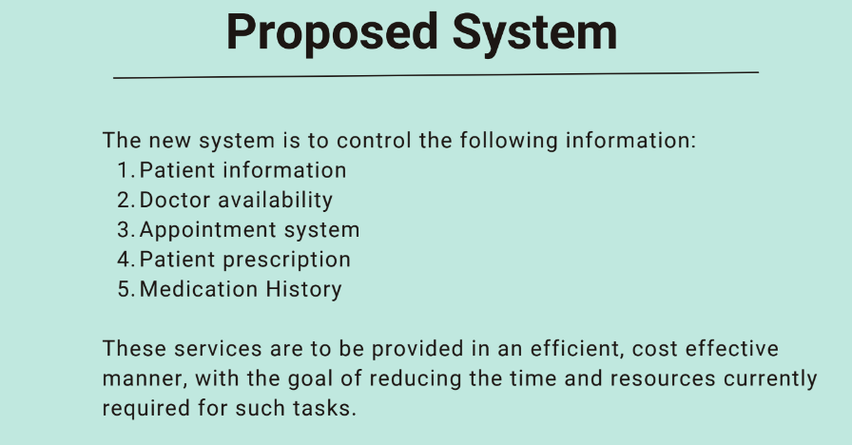

Slide 6


Slide 7


Slide 8


Slide 9
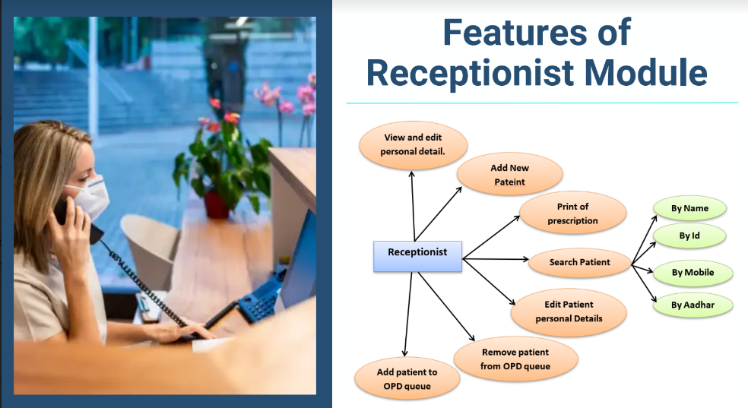

Slide 10
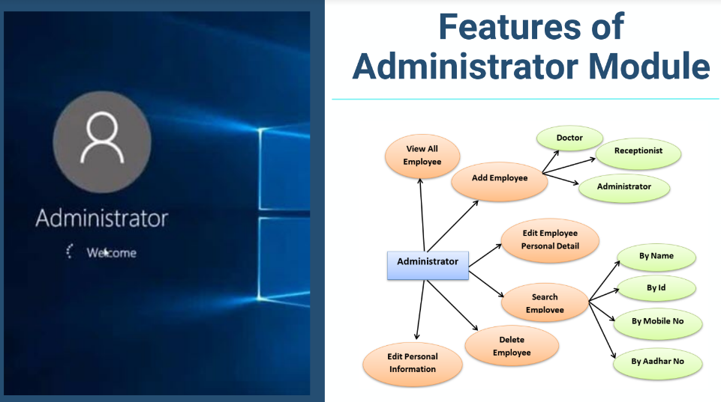

Slide 11


Slide 12


Slide 13
THANK YOU
SANDEEP KODARI
STUID : STU61b4d3d9ecaa81639240665

